Slide 1
Distributed Systems
Topics
  What is a Distributed System?
  Why Distributed Systems?
  Examples of Distributed Systems
  Distributed System Requirements
  Transparency in Distributed Systems
Distributed Systems

Slide 2
Distributed Systems
Can think of DS as:
  breaking down an application into individual computing agents
  distributed over a network
  work together on a cooperative task
Motivation for DC:
  Scalability: can solve larger problems without larger computers
  Openness and heterogeneity: applications and data may be difficult to relocate and reconfigure
  Fault-tolerance: redundant processing agents for system availability
Distributed Systems

Slide 3
What Is a Distributed System?
Ingredients of a Distributed System
Component-1
…
Component-n
Component-1
…
Component-m
Network OS
Network OS
Hardware
Hardware
Host-1
Host-n
Component-1
…
Component-n
Middleware
Network OS
Hardware
Host-1
Distributed Systems

Slide 4
What Is a Distributed System?
Component-1
…
Component-n
Component-1
…
Component-n
Middleware
Middleware
Network OS
Network OS
Hardware
Hardware
Host-1
Host-2
Network
Component-1
…
Component-n
Component-1
…
Component-n
Middleware
Middleware
Network OS
Network OS
Hardware
Hardware
Host-n
Host-3
Distributed Systems

Slide 5
What is a Distributed System
Distributed System Definition:
  A distributed system is a collection of autonomous hosts that are connected through a computer network.
  Each host executes components and operates a distribution middleware.
  Middleware enables the components to coordinate their activities.
  Users perceive the system as a single, integrated computing facility.
Distributed Systems

Slide 6

Why Distributed Systems?
Every application is part of your business model
  must make them work together!
Payables/ Receivables
Sales
Accounting
Manufacturing
Inventory
Shipping/ Receiving
Engineering
Distributed Systems

Slide 7
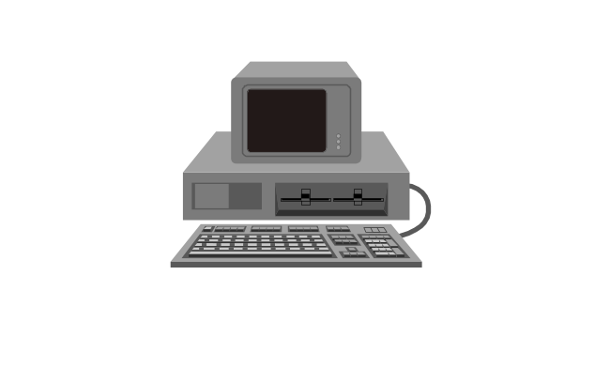
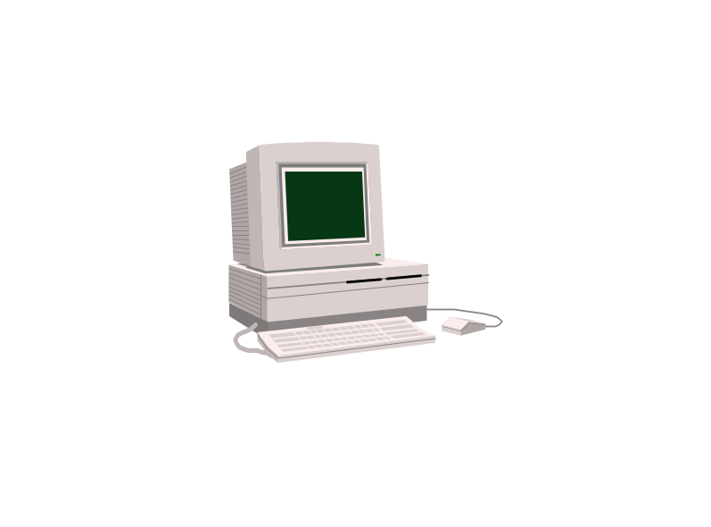

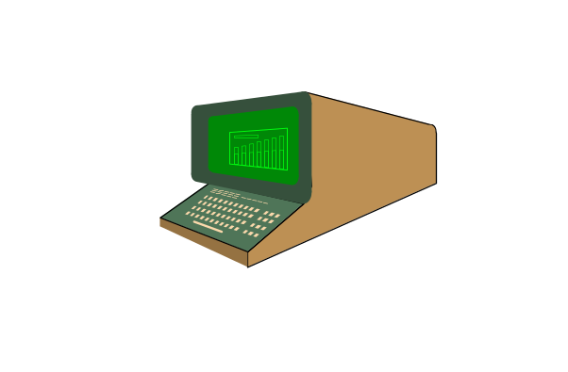
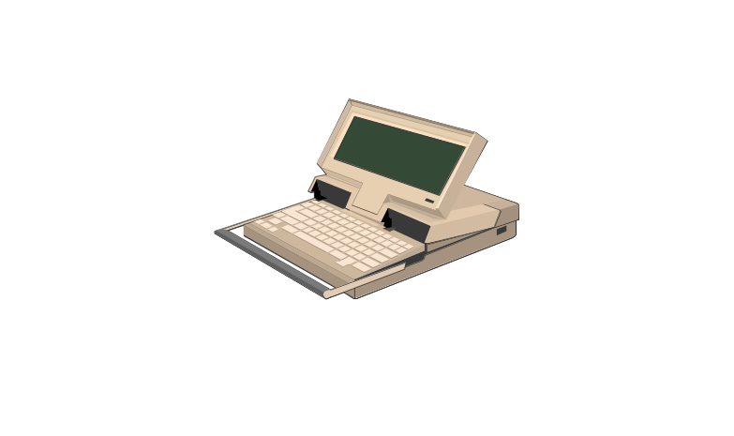
Why Distributed Systems?
Application Integration and Distributed Processing are the same thing
  Constructing information-sharing distributed systems from diverse sources:
    heterogeneous
    networked
    physically disparate
    multi-vendor
Distributed Systems

Slide 8
Why Distributed System?
Application Requirements
  Functional
  Non-Functional
Non-functional requirements drive distribution of a system
  Scalability
  Concurrency
  Openness
  Heterogeneity
  Resource sharing
  Fault-tolerance
  …
Distributed Systems
Notes:
Scalability denotes the ability to accommodate a growing load in the future.
Open systems can easily be extended and modified. It is achieved by communicating using well-defined interfaces.
Heterogeneity of components can arise in the programming languages, operating systems, hardware platforms and network protocols. Component heterogeneity can be accommodated by distributed systems.
Often resources, i.e., hardware, software, and data need to be shared by more than one user. Distributed objects provide a sophisticated model of resource sharing.
Security needs to be considered when it comes to sharing
Fault-tolerance refers that operations can continue even in the presence of faults. It is achieved in distributed system by means of replication

Slide 9
Centralized vs Distributed Systems
Centralized Systems
  Centralized systems have non-autonomous components
  Centralized systems are often build using homogeneous technology
  Multiple users share the resources of a centralized system at all times
  Centralized systems have a single point of control and of failure
Distributed Systems
  Distributed systems have autonomous components
  Distributed systems may be built using heterogeneous technology
  Distributed system components may be used exclusively
  Distributed systems are executed in concurrent processes
  Distributed systems have multiple points of failure
Distributed Systems

Slide 10
Advantages and Disadvantages of Distributed Systems
Advantages
  Shareability
  Expandability
  Local autonomy
  Improved performance
  Improved reliability and availability
  Potential cost reductions
Disadvantages
  Network reliance
  Complexities
  Security
  Multiple point of failure
Distributed Systems

Slide 11
History Review of Distributed Systems
Late 70’s and early 80’s: synchronous with distributed processing
Mid 80’s: no point of central control
Late 80’s: peer structure and inter-connection configuration
Later: more fine-grained distribution
  Software is decomposed into components
  Components can resides on different computers and be implemented with different languages
Distributed Systems

Slide 12
SEPARATION OF CONCERNS
Separation of concerns is the software engineering principle that each component should have a single small job to do so it can do it well.
In distributed systems, there are at least three concerns having to do with remote services: what to request, where to do it, how to ask for it.
Notes:
[pg 34] (diagrams on next slide)

Slide 13
IDEAL SEPARATION
What to request: application programmer must figure this out, e.g. access customer database.
Where to do it: application programmer should not need to know where, because this adds complexity + if location changes, application break.
How to ask for it: want a uniform interface.

Slide 14
ALTERNATIVE: NAME SERVER
A service is a piece of work to do. Will be done by a server. Name Server knows where services are done
Example: Client requests address of server from the Name Server and then communicates directly with that server..
Difference: Client-server communication is direct, so may be more efficient.
client…client
client
Service broker
Client … client
server
Notes:
[pg 33]

Slide 15
HOW TO ASK FOR IT:
OBJECT-BASED
Encapsulation of data behind functional interface.
Inheritance is optional but interface is the contract.
So need a technique for both synchronous and asynchronous procedure calls.

Slide 16
REFERENCE EXAMPLE:
CORBA OBJECT REQUEST BROKER
Send operation to ORB with its parameters.
ORB routes operation to proper site for execution.
Arranges for response to be sent to you directly or indirectly.
Operations can be “events” so can allow interrupts from servers to clients.

Slide 17
Microsoft Products
COM: allow objects to call one another in a centralized setting: classes + objects of those classes. Can create objects and then invoke them.
DCOM: COM + Object Request Broker.
ActiveX: DCOM for the Web.

Slide 18
Java RMI
Remote Method invocation (RMI): Define a service interface in Java.
Register the server in RMI repository, i.e., an object request broker.
Client may access Server through repository.
Notion of distributed garbage collection

Slide 19
Examples of Distributed Systems
Video-on-Demand
  Client components are used to display videos
  Clients are hosted in the homes of the customers of the service
  Server components load and transmit videos
  Multiple servers are needed in order to scale
Distributed Systems

Slide 20
Examples of Distributed Systems
IT Service Architecture of a Swiss Bank
  Service architecture consists of heterogeneous new and legacy components
  Hardware platforms range from mainframes to NTs
  Programming languages including Assembler, Cobol, C, C++, Java, …
  Different types of middleware can be used to resolve distribution and heterogeneity
Authorization Services
Customer Information Services
Trading Services
ATM Services
Distributed Systems

Slide 21
Transparency in Distributed Systems
Distributed System Definition: A distributed system is a collection of autonomous hosts that are connected through a computer network and coordinate with each other in such a way that users perceive the system as a single and integrated computing facility.
Dimensions of transparency in DS
  Access Transparency
  Location Transparency
  Migration Transparency
  Replication Transparency
  Concurrency Transparency
  Scalability Transparency
  Performance Transparency
  Failure Transparency
Distributed Systems
Notes:
Access transparency means that the interfaces for local and remote communication are the same (Unix networked file systems)
Location transparency means that service requesters do not need to know physical component locations (NFS in unix environment, we don’t need to the ip address).
Migration transparency means that the component can be relocated without users or clients noticing it. It depends on both access and location transparency.
Replication transparency means the users and programmers do not know whether a replica or a master provides a service (a replica is a component copy that remains synchronized with its original.) Example: video-on-demand. It depends on access and location transparency
Concurrency transparency means that users and programmers are unaware that components request services concurrently. (Bank application is an example)
Scalability transparency means that users and programmers do not know how scalability of a distributed system is achieved. (The Internet is an example). It depends on replication and migration transparency.
Performance transparency means that users and programmers are unaware how good system performance is maintained. (Example: distributed version of make). It depends on replication and migration transparency.
Failure transparency means that users and programmers are unaware of how distributed systems conceal failures. It depends on concurrency and replication transparency. (Example: banking applications)

Slide 22
Location Transparency
Caller
Machine 1
Machine 2
local
call
remote
call
Implementor
Proxy
Distributed Systems

Slide 23
Summary
Distributed systems
Centralized systems vs distributed systems
The need for distributed systems --- application’s non-functional requirements
Transparencies
Dependencies among different dimensions of transparencies
Distributed Systems

